Slide 1


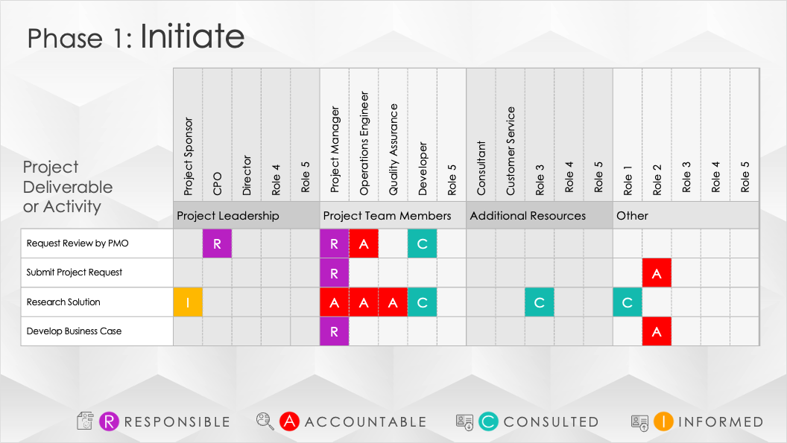
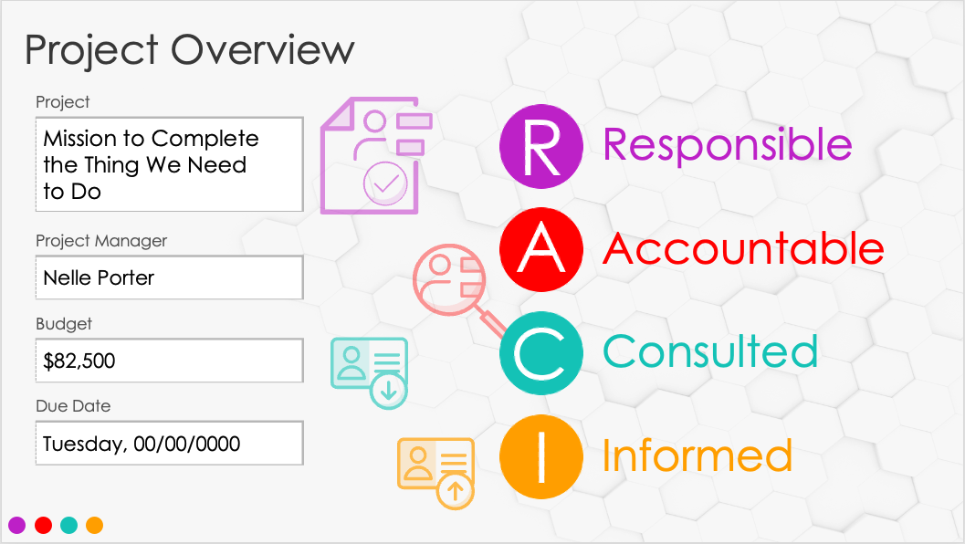




Simple RACI Matrix Template
Example

Slide 2




RACI
Matrix
Responsible
Accountable
Consulted
Informed
00/00/0000

Slide 3
Project Overview
Project
Mission to Complete the Thing We Need to Do
Responsible
Accountable
Project Manager
Nelle Porter
Budget
Consulted
$82,500
Due Date
Tuesday, 00/00/0000
Informed

Slide 4




Phase 1: Initiate
 |  | Project Sponsor | CPO | Director | Role 4 | Role 5 | Project Manager | Operations Engineer | Quality Assurance | Developer | Role 5 | Consultant | Customer Service | Role 3 | Role 4 | Role 5 | Role 1 | Role 2 | Role 3 | Role 4 | Role 5
 |  | Project Leadership |  |  |  |  | Project Team Members |  |  |  |  | Additional Resources |  |  |  |  | Other
Request Review by PMO |  |  | R |  |  |  | R | A |  | C
Submit Project Request |  |  |  |  |  |  | R |  |  |  |  |  |  |  |  |  |  | A
Research Solution |  | I |  |  |  |  | A | A | A | C |  |  |  | C |  |  | C
Develop Business Case |  |  |  |  |  |  | R |  |  |  |  |  |  |  |  |  |  | A
Project
Deliverable
or Activity
RESPONSIBLE
ACCOUNTABLE
CONSULTED
INFORMED

Slide 5
Phase 2: Plan
 |  | Project Sponsor | CPO | Director | Role 4 | Role 5 | Project Manager | Operations Engineer | Quality Assurance | Developer | Role 5 | Consultant | Customer Service | Role 3 | Role 4 | Role 5 | Role 1 | Role 2 | Role 3 | Role 4 | Role 5
 |  | Project Leadership |  |  |  |  | Project Team Members |  |  |  |  | Additional Resources |  |  |  |  | Other
Create Project Charter |  | C | C |  |  |  | R | C | C | C |  |  |  | C |  |  | C
Create Schedule |  | I | I | I | I |  | R | C | C | C | C | C | C | C |  |  | C | I
Create Additional Plans as Required |  | I | I | I |  |  | R |  |  |  | I | I | I | I |  |  | C | I
Project
Deliverable
or Activity
RESPONSIBLE
ACCOUNTABLE
CONSULTED
INFORMED

Slide 6
Phase 3: Execute
 |  | Project Sponsor | CPO | Director | Role 4 | Role 5 | Project Manager | Operations Engineer | Quality Assurance | Developer | Role 5 | Consultant | Customer Service | Role 3 | Role 4 | Role 5 | Role 1 | Role 2 | Role 3 | Role 4 | Role 5
 |  | Project Leadership |  |  |  |  | Project Team Members |  |  |  |  | Additional Resources |  |  |  |  | Other
Build Deliverables |  | C | C | C | C |  |  | R | R | R | R | A |  |  |  |  | A
Create Status Report |  | I | I | I | I |  | A | A | A | A |  |  |  |  |  |  | C | I
Project
Deliverable
or Activity
RESPONSIBLE
ACCOUNTABLE
CONSULTED
INFORMED

Slide 7
Phase 4: Control
 |  | Project Sponsor | CPO | Director | Role 4 | Role 5 | Project Manager | Operations Engineer | Quality Assurance | Developer | Role 5 | Consultant | Customer Service | Role 3 | Role 4 | Role 5 | Role 1 | Role 2 | Role 3 | Role 4 | Role 5
 |  | Project Leadership |  |  |  |  | Project Team Members |  |  |  |  | Additional Resources |  |  |  |  | Other
Perform Change Management |  |  | C | C | C |  | R | A | A | A |  |  |  |  |  |  | C | I
Project
Deliverable
or Activity
RESPONSIBLE
ACCOUNTABLE
CONSULTED
INFORMED

Slide 8
Phase 5: Close
 |  | Project Sponsor | CPO | Director | Role 4 | Role 5 | Project Manager | Operations Engineer | Quality Assurance | Developer | Role 5 | Consultant | Customer Service | Role 3 | Role 4 | Role 5 | Role 1 | Role 2 | Role 3 | Role 4 | Role 5
 |  | Project Leadership |  |  |  |  | Project Team Members |  |  |  |  | Additional Resources |  |  |  |  | Other
Create Lessons Learned |  | C | C | C | C |  | R | C | C | C | C | C | C | C |  |  | C | C
Create Project Closure Report |  | I | I | I | I |  | A | I | I | I | I | I | I | I |  |  |  | I
Project
Deliverable
or Activity
RESPONSIBLE
ACCOUNTABLE
CONSULTED
INFORMED

Slide 9
Notes
summary information / comments

Slide 10
DISCLAIMER Any articles, templates, or information provided by Smartsheet on the website are for reference only. While we strive to keep the information up to date and correct, we make no representations or warranties of any kind, express or implied, about the completeness, accuracy, reliability, suitability, or availability with respect to the website or the information, articles, templates, or related graphics contained on the website. Any reliance you place on such information is therefore strictly at your own risk.

