Slide 1

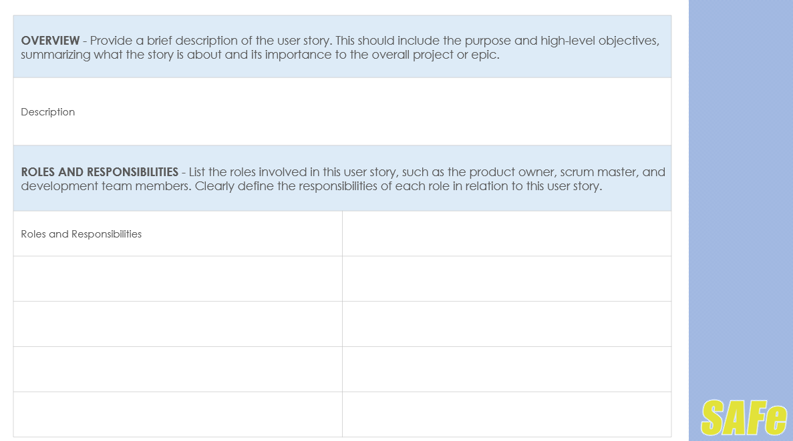
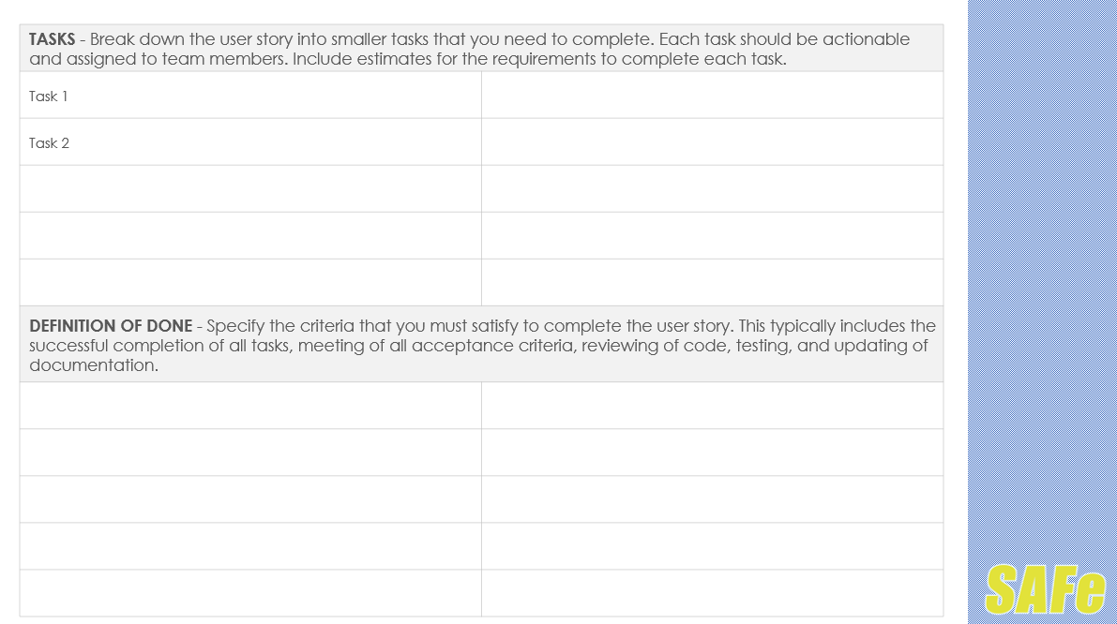
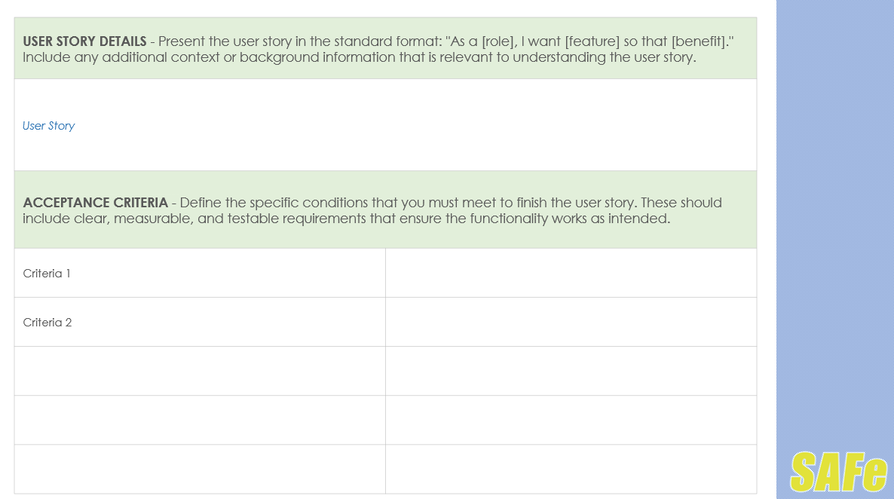
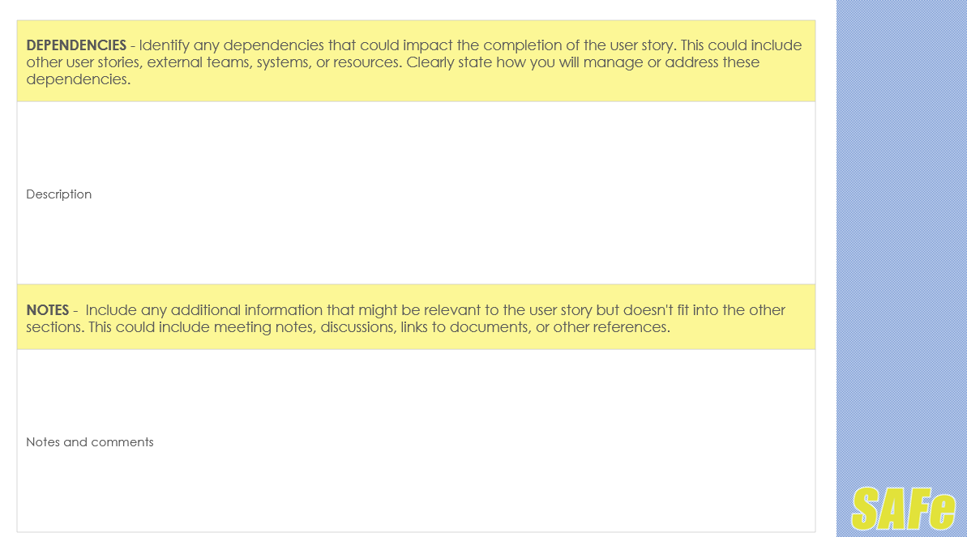

Scaled Agile Framework User Story Template

Slide 2
OVERVIEW - Provide a brief description of the user story. This should include the purpose and high-level objectives, summarizing what the story is about and its importance to the overall project or epic.
Description
ROLES AND RESPONSIBILITIES - List the roles involved in this user story, such as the product owner, scrum master, and development team members. Clearly define the responsibilities of each role in relation to this user story.
Roles and Responsibilities

Slide 3
USER STORY DETAILS - Present the user story in the standard format: "As a [role], I want [feature] so that [benefit]." Include any additional context or background information that is relevant to understanding the user story.
User Story
ACCEPTANCE CRITERIA - Define the specific conditions that you must meet to finish the user story. These should include clear, measurable, and testable requirements that ensure the functionality works as intended.
Criteria 1
Criteria 2

Slide 4
TASKS - Break down the user story into smaller tasks that you need to complete. Each task should be actionable and assigned to team members. Include estimates for the requirements to complete each task.
Task 1
Task 2
DEFINITION OF DONE - Specify the criteria that you must satisfy to complete the user story. This typically includes the successful completion of all tasks, meeting of all acceptance criteria, reviewing of code, testing, and updating of documentation.

Slide 5
DEPENDENCIES - Identify any dependencies that could impact the completion of the user story. This could include other user stories, external teams, systems, or resources. Clearly state how you will manage or address these dependencies.
Description
NOTES - Include any additional information that might be relevant to the user story but doesn't fit into the other sections. This could include meeting notes, discussions, links to documents, or other references.
Notes and comments

Slide 6
DISCLAIMER Any articles, templates, or information provided by Smartsheet on the website are for reference only. While we strive to keep the information up to date and correct, we make no representations or warranties of any kind, express or implied, about the completeness, accuracy, reliability, suitability, or availability with respect to the website or the information, articles, templates, or related graphics contained on the website. Any reliance you place on such information is therefore strictly at your own risk.

