Slide 1

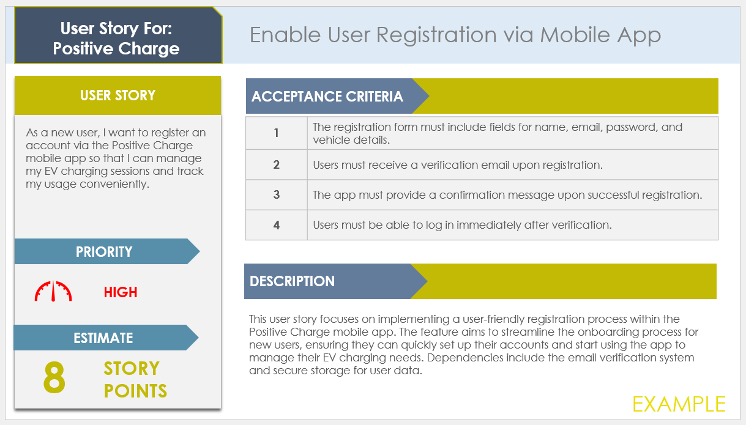
Basic User Story Slide
Template Example

Slide 2

User Story For:
Positive Charge
Enable User Registration via Mobile App
USER STORY
ACCEPTANCE CRITERIA
As a new user, I want to register an account via the Positive Charge mobile app so that I can manage my EV charging sessions and track my usage conveniently.
1 | The registration form must include fields for name, email, password, and vehicle details.
2 | Users must receive a verification email upon registration.
3 | The app must provide a confirmation message upon successful registration.
4 | Users must be able to log in immediately after verification.
PRIORITY
DESCRIPTION
HIGH
This user story focuses on implementing a user-friendly registration process within the Positive Charge mobile app. The feature aims to streamline the onboarding process for new users, ensuring they can quickly set up their accounts and start using the app to manage their EV charging needs. Dependencies include the email verification system and secure storage for user data.
ESTIMATE
8
STORY POINTS
EXAMPLE

Slide 3

User Story For:
Positive Charge
Add Payment Method for Charging Sessions
USER STORY
ACCEPTANCE CRITERIA
As a registered user, I want to add and manage my payment methods in the app so that I can seamlessly pay for my EV charging sessions.
1 | The payment section must accept credit/debit cards and PayPal.
2 | Users must be able to add, edit, and delete payment methods.
3 | The app must securely store payment information in compliance with PCI DSS.
4 | Users must receive confirmation messages for any changes made to their payment methods.
PRIORITY
DESCRIPTION
MEDIUM
This user story aims to provide users with a convenient way to manage their payment methods within the Positive Charge app. By offering multiple payment options and ensuring secure handling of payment information, the feature enhances the overall user experience and facilitates easy transactions for charging sessions.
ESTIMATE
5
STORY POINTS
EXAMPLE

Slide 4
User Story For:
Positive Charge
Locate Nearest Charging Stations
USER STORY
ACCEPTANCE CRITERIA
As an EV driver, I want to locate the nearest Positive Charge stations using the app so that I can plan my trips and charge my vehicle efficiently.
1 | The app must display a map with nearby Positive Charge stations.
2 | Users must be able to filter stations by availability, charging speed, and amenities.
3 | The app must provide directions to the selected charging station.
4 | Users must receive real-time updates on station status and availability.
PRIORITY
DESCRIPTION
HIGH
This user story focuses on enhancing the Positive Charge app's functionality by integrating a map feature that shows the nearest charging stations. This feature is crucial for helping EV drivers plan their trips and find available charging stations quickly. Dependencies include real-time data integration and map service APIs.
ESTIMATE
13
STORY POINTS
EXAMPLE

Slide 5
User Story For:
Positive Charge
Schedule Charging Sessions
USER STORY
ACCEPTANCE CRITERIA
As a busy professional, I want to schedule my EV charging sessions in advance so that I can ensure my vehicle is charged without waiting in line.
1 | The scheduling feature must allow users to select date and time for charging.
2 | Users must receive notifications before the scheduled session.
3 | The app must prevent double bookings and show available time slots.
4 | Users must be able to reschedule or cancel their sessions with ease.
PRIORITY
DESCRIPTION
MEDIUM
This user story aims to introduce a scheduling feature in the Positive Charge app, enabling users to book their charging sessions in advance. By allowing users to plan their charging times, the feature reduces wait times and enhances the convenience of using Positive Charge stations.
ESTIMATE
8
STORY POINTS
EXAMPLE

Slide 6

User Story For:
Name
Story Title
USER STORY
ACCEPTANCE CRITERIA
User story …
1 | Criteria
2 | Criteria
3 | Criteria
4 | Criteria
PRIORITY
HIGH
MEDIUM
LOW
DESCRIPTION
Description…
ESTIMATE
0
STORY POINTS

Slide 7
DISCLAIMER Any articles, templates, or information provided by Smartsheet on the website are for reference only. While we strive to keep the information up to date and correct, we make no representations or warranties of any kind, express or implied, about the completeness, accuracy, reliability, suitability, or availability with respect to the website or the information, articles, templates, or related graphics contained on the website. Any reliance you place on such information is therefore strictly at your own risk.

